Slide 1

Monte Carlo Tree (Ms. Pac-Man)
Jesus Adame

Slide 2
What is a Monte Carlo Tree Search?
The Monte Carlo Tree Search is an algorithm for making decisions in artificial intelligence problems, typically found in combination and move planning games.

Slide 3
What is a Monte Carlo Tree Search? (continued)
This Tree can be broken down into four steps, that is,
1. Selection: Starting at the root node, children are chosen according to a selection policy. When a leaf node is reached that does not represent a terminal state, it is selected for expansion.
2.Expansion: All children are added to the selected leaf node given available moves
3.Playout: A random simulation is run, starting from the state of the added node where random decisions are made until the terminal state.
4.Backpropagation: Once the simulation is finished, the play out is backed up or traversed back to the root node updating the stats for each node.

Slide 4
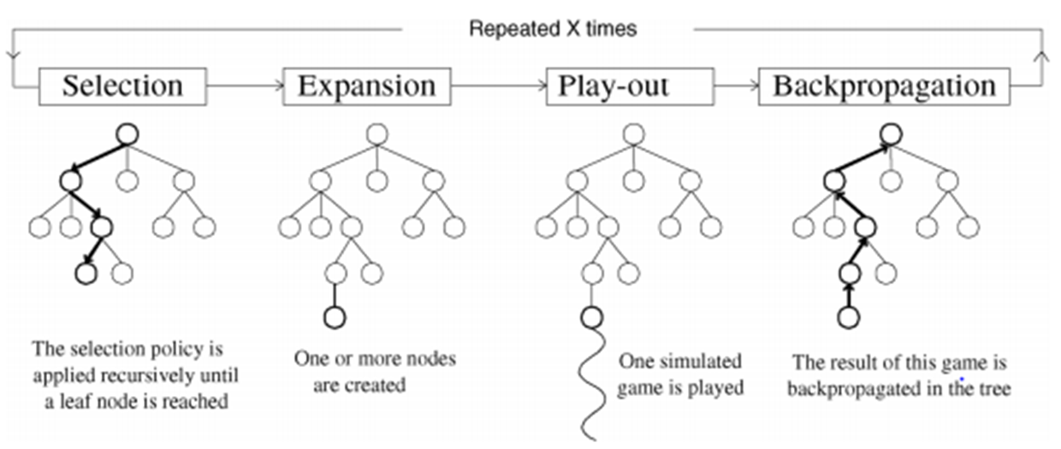
Visual Representation of the MCST
Tom Pepels, Mark H. M. Winands (2014)

Slide 5

Formula Used For Selection & Expansion (Upper Confidence Bound1)
Xi is the mean reward (value) for child i.
T is number of searches performed by the parent node
Ti is the number if searches performed by the same child node i.
C is the exploration constant.

Slide 6

Upper Confidence Bound1 (continued)
If Ti is 0,or if node is visited for the first time, a number “n” will be chosen and assigned when performing a playout
Other wise if Ti is greater than 0, the UCB1 formula will be used to calculate the value.
When using this formula we want to select the node with the highest value.

Slide 7
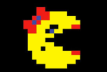
Numerical Example of MCST
Ms. Pac-Man has a choice to make from the root node, that is go to node A or B.
As she proceeds she wishes to reach the node s with the highest value
Once a leaf node is reach we get a play out and the process starts all over again in a loop
1/25
A=2/3
B=1/2
C=61/3
D=6/7
0

Slide 8
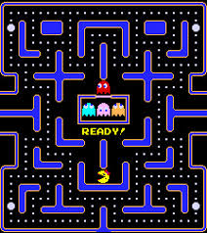

What is Ms. Pac-Man?
A popular video game released in the 1980’s.
The objective is for Ms. Pac-Man to maneuver through a maze, and eat as many pills as possible, while avoiding contact with the ghosts.
As the levels progress the ghosts move faster in different behavioral patterns.

Slide 9
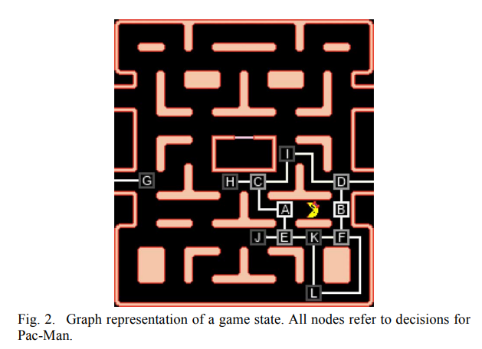
How can the MCST be applied in Ms. Pac-Man?
The game consists of four different mazes. Where these can be represented as a graph.
The junctions are the nodes.
The corridors between the junctions are edges.
Ms. Pac-Man has the option to make a decision at any point within the graph.
Tom Pepels, Mark H. M. Winands (2014)

Slide 10
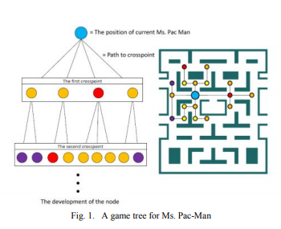
How can the MCST be applied in Ms. Pac-Man? (cont.)
Nozomu Ikehata and Takeshi Ito (2011)

Slide 11
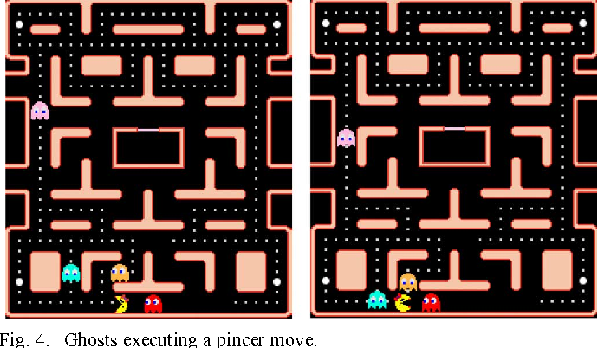
How can the MCST be applied in Ms. Pac-Man? (cont.)
The idea of using the MCST here is to increase the survival rate of Ms. Pac-Man.
In other words, we want to avoid from her getting trapped by the ghosts with no escape route.
Nozomu Ikehata and Takeshi Ito (2011)

Slide 12

Data Set and Results
Proposed system was set to autonomously control Ms. Pac-Man to see its performance.
Program was executed 20 times.
# simulations was set to 300 and the maximum number of cycles of simulation was set to 30
Nozomu Ikehata and Takeshi Ito (2011)

Slide 13

Data Set and Results (cont)
These are the number of stages reached during the competition
Where the winner is the “Proposed system”
Nozomu Ikehata and Takeshi Ito (2011)

Slide 14
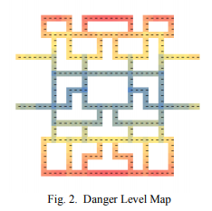
Observations of Results
Evidently the proposed system using the MCTS worked since it avoided eating pills where it felt it was going to be trapped.
Nozomu Ikehata and Takeshi Ito (2011)

Slide 15
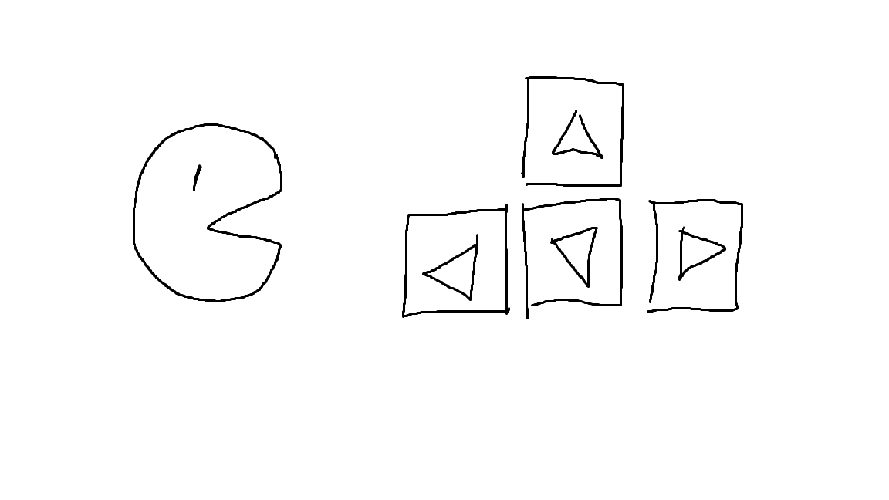
PacMan
UP Down Left Right or
do nothing

Slide 16
So we set Rule
One move in 40 ms

Slide 17
UP DOWN LEFT RIGHT

Slide 18
Why do we not need stop?
←→←→←→←→

Slide 19
What happens in 40ms

Slide 20
MCTS vs Depth First Search
MCTS
No tactical knowledge required to implement the algorithm
performs asymmetric tree growth that adapts to the topology of the search space
The algorithm can be terminated and reused during anytime
DFS
Memory is linear
Time complexity of O(n)
Finds solution without exploring much, thus creating more time and space

Slide 21
Application of Other Fields
Alpha Go (MCTS with Deep Learning)
Game that has combo (Dots and Boxes)
General Artificial Intelligence for Video Games

Slide 22
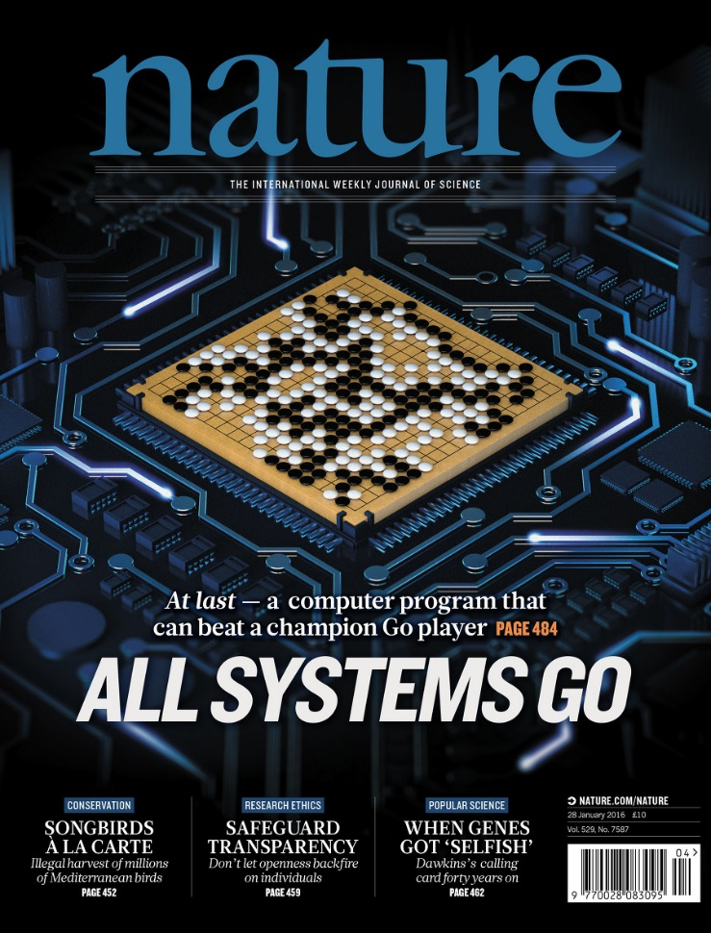
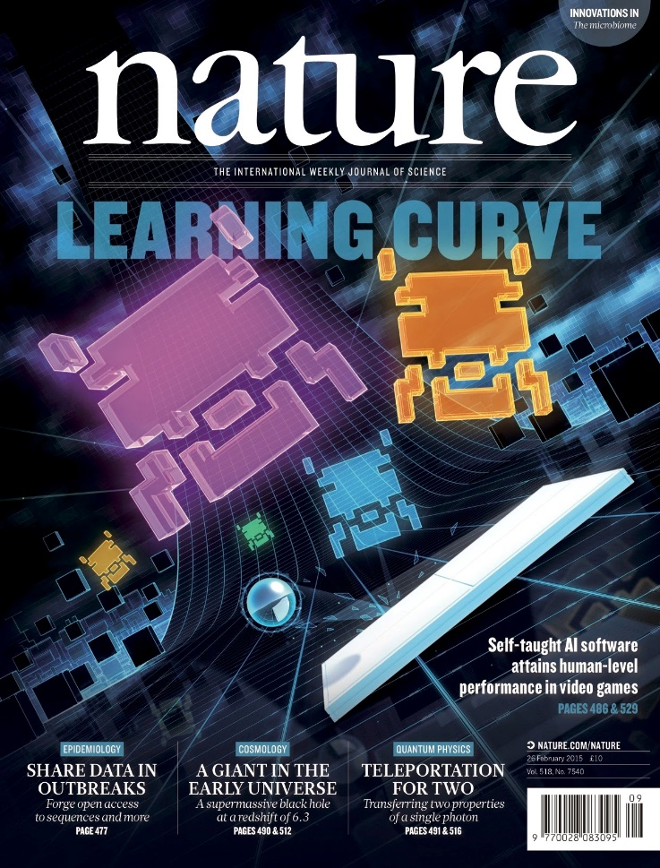

Slide 23
Pros vs Cons
We can use it generally for games which we cannot find the best way
Need to make an appropriate rule.

Slide 24
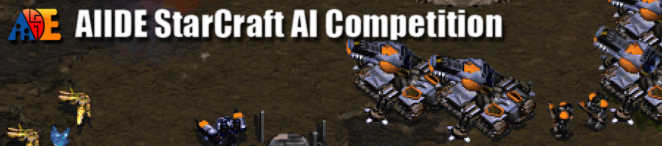
Current Research Problems
Helped in producing better Ai in StarCraft for better competitions
Helps in planning problems for a “Petrobras company.”
This company uses the MCTS for particular transportation problems.
Planning deals with problems of selection and causally ordering of actions to
achieve a given goal from a known initial situation.
Therefore, The MCTS beats the classical planer SG plan, in terms of solution quality.

Slide 25
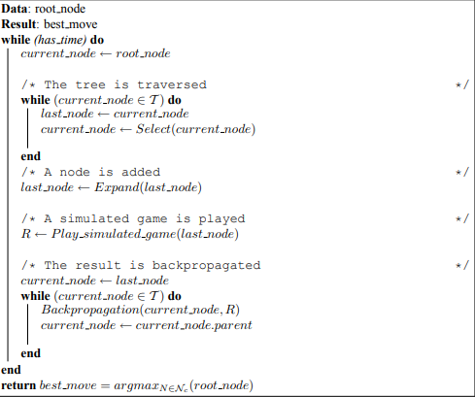
Pseudocode for MCST

Slide 26
References
Rohlfshagen, Philipp, and Simon M. Lucas. “Ms Pac-Man versus Ghost Team CEC 2011 Competition.” Evolutionary Computation (CEC), 2011 IEEE Congress On, 2011, pp. 70–77.
Powley, et al. “Information Capture and Reuse Strategies in Monte Carlo Tree Search, with Applications to Games of Hidden Information.” Artificial Intelligence, vol. 217, no. C, 2014, pp. 92–116
Pepels, Tom, et al. “Real-Time Monte Carlo Tree Search in Ms Pac-Man.” Computational Intelligence and AI in Games, IEEE Transactions On, vol. 6, no. 3, 2014, pp. 245–257.
Rohlfshagen, Philipp, and Simon M. Lucas. “Ms Pac-Man versus Ghost Team CEC 2011 Competition.” Evolutionary Computation (CEC), 2011 IEEE Congress On, 2011, pp. 70–77.
Ikehata, Nozomu, and Takeshi Ito. “Monte-Carlo Tree Search in Ms. Pac-Man.” Computational Intelligence and Games (CIG), 2011 IEEE Conference On, 2011, pp. 39–46.
Pepels, T., and M. H. M. Winands. “Enhancements for Monte-Carlo Tree Search in Ms Pac-Man.” Computational Intelligence and Games (CIG), 2012 IEEE Conference On, 2012, pp. 265–272.
Kien Quang Nguyen, and Thawonmas. “Monte Carlo Tree Search for Collaboration Control of Ghosts in Ms. Pac-Man.” IEEE Transactions on Computational Intelligence and AI in Games, vol. 5, no. 1, 2013, pp. 57–68.
Brauers, I. M. M. "Monte-Carlo Evaluations in Ms. Pac-Man." (2011).
Samothrakis, et al. “Fast Approximate Max-n Monte Carlo Tree Search for Ms Pac-Man.” Computational Intelligence and AI in Games, IEEE Transactions On, vol. 3, no. 2, 2011, pp. 142–154.
D. Brand and S. Kroon. Sample evaluation for action selection in monte carlo tree search. In Proceedings of the Southern African Institute for Computer Scientist and Information Technologists Annual Conference 2014 on SAICSIT 2014 Empowered by Technology, SAICSIT ’14, pages 314:314–314:322, New York, NY, USA, 2014. ACM
Bouzy, B. (2006). Associating Shallow and Selective Global Tree Search with Monte Carlo for 9×9 Go. Computers and Games (CG 2004) (eds. H.J. van den Herik, Y. Bjornsson, ¨ and N. Netanyahu), Vol. 3846 of LNCS, pp. 67–80, Springer-Verlag, Berlin Heidelberg, Germany.[13, 17]
Chaslot, G., Bakkes, S., Szita, I., Spronck, P.: Monte-Carlo Tree Search: A New Framework for Game AI. In: Proceedings of the 4th Artificial Intelligence for Interactive Digital Entertainment conference (AIIDE), pp. 216–217. AAAI Press (2008)

Slide 27
Q&A

